Slide 1
Latent Semantic Analysis
A NLP based Project
Akarsh Somani and Gaurav Misra

Slide 2
What is Latent Semantic Analysis?
Latent semantic analysis (LSA) is a technique in natural language processing, in particular distributional semantics, of analyzing relationships between a set of documents and the terms they contain by producing a set of concepts related to the documents and terms.
LSA assumes that words that are close in meaning will occur in similar pieces of text.
E.g. Two Sports Document will have more similarity than a Sport and Movie Document.
This is because similar topic will have words which are close in meaning with that topic.

Slide 3
Why LSA?
Latent Semantic Analysis is a technique for creating a vector representation of a document.
Having a vector representation of a document gives you a way to compare documents for their similarity by calculating the distance between the vectors.
This in turn means you can do handy things like classifying documents to determine which of a set of known topics they most likely belong to.

Slide 4
Why LSA different from classification?
Classification implies you have some known topics that you want to group documents into, and that you have some labelled training data.
If you want to identify natural groupings of the documents without any labelled data, you can use clustering.
LSA uses words meaning to assign them to a Topic

Slide 5
Steps to LSA
First we have to form doc-term matrix of the TF-IDF(term frequency–inverse document frequency) scores of the word frequency in each document.
This matrix contain 1000’s of vector.
Then we will do the dimensionality reduction with SVD(singular-value decomposition)
The SVD step does more than just reduce the computational load–that is large number of features for a smaller set of better features.
Paragraphs are then compared by taking the cosine of the angle between the two vectors (or the dot product between the normalizations of the two vectors) formed by any two columns.
Values close to 1 represent very similar paragraphs while values close to 0 represent very dissimilar paragraphs.

Slide 6
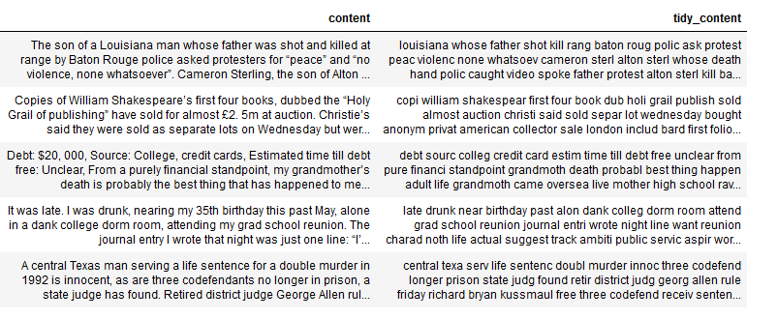
Our Methodology
Cleaning the Document which includes removal of unnecessary symbols, stop words removal, stemming, etc..

Slide 7
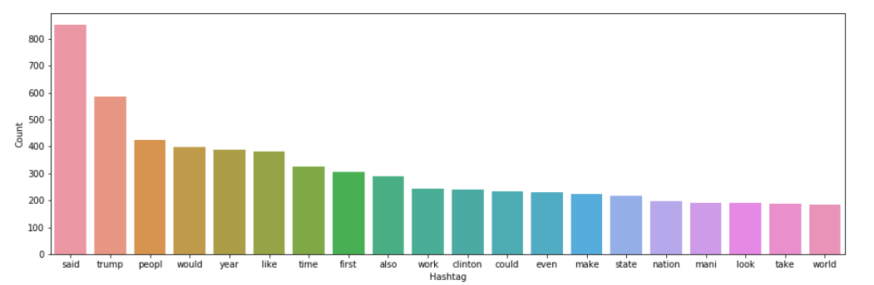
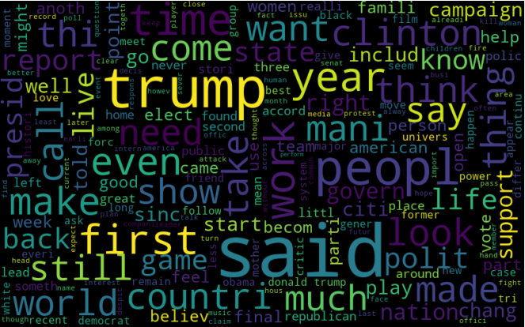
Our Methodology
We have considered total 200 News Articles(as of now and can be modified)
The word cloud for the documents.
The more the occurrence of the word the more is the size of the word in the word cloud

Slide 8
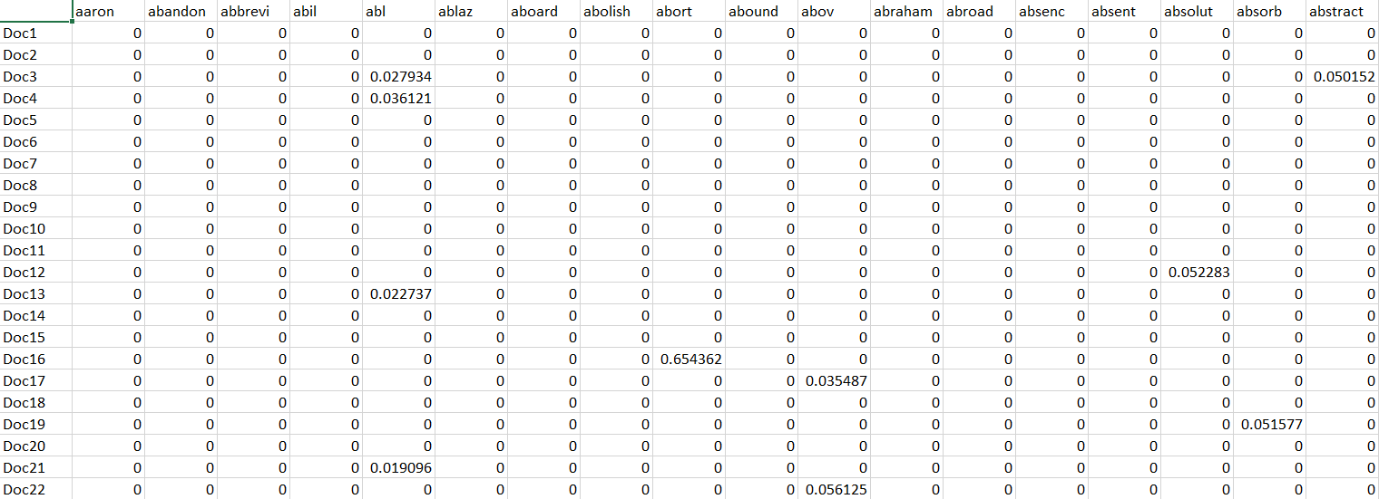
Our Methodology Continued
Creating Document-Term Matrix for TF-IDF scores as will as Occurrence Score from the set of cleaned document.
We have 5272 Terms and 200 Documents.

Slide 9
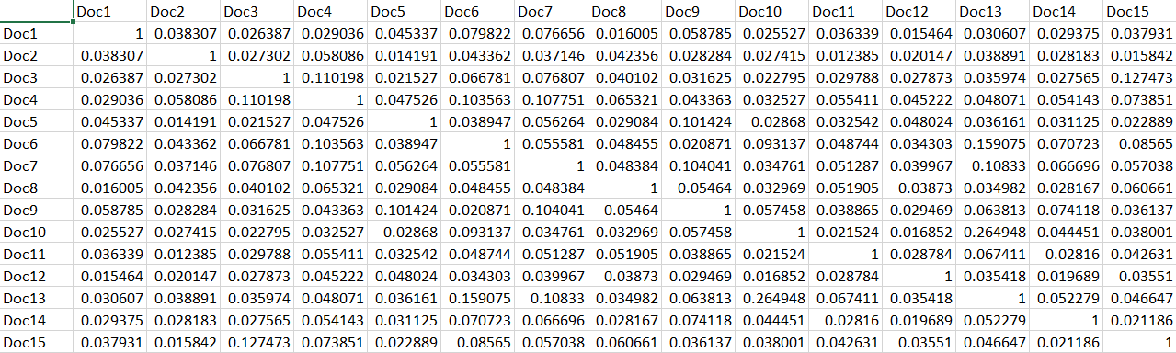
Our Methodology Continued
Now we will find cosine similarity to compare the similarity of the documents
Cosine similarity(Doc-Doc Matrix) = Doc-Term Doc-Term^{T}
The shape of the Doc-Doc Matrix is 200 X 200

Slide 10
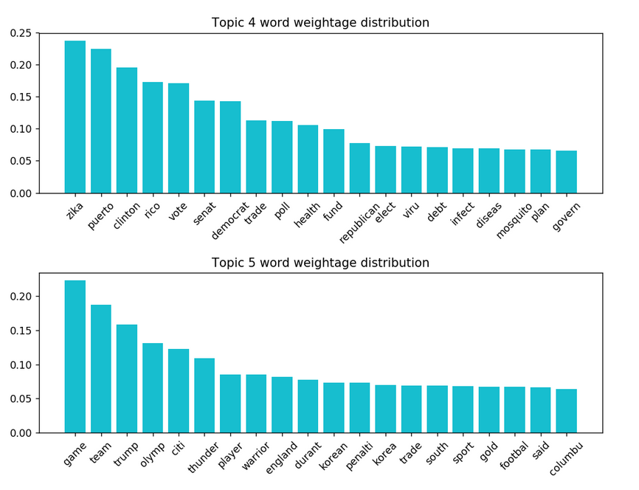
Our Methodology Continued
Feed the Doc-Term matrix of TF-IDF score to the SVD model with n-component equals to 5(let suppose).
It will return 5 topic i.e. all the words for a topic with different weight.
The shown figure is the topic 4 and 5 for top 20 words with different weight assigned to it.

Slide 11
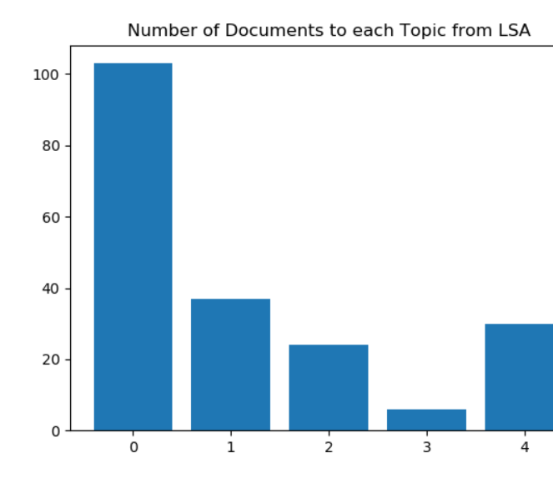
Our LSA Result
The Frequency of document assigned to each Topic is as shown.
Topic with max frequency has 103 documents and Topic with min frequency has almost 6 documents

Slide 12
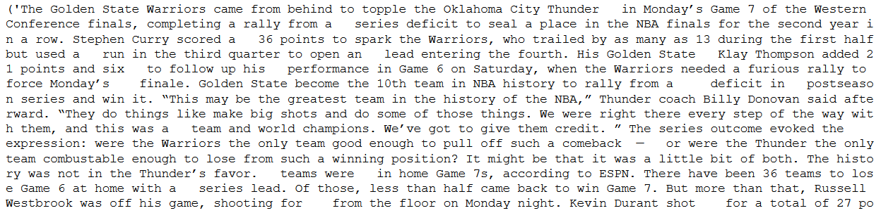
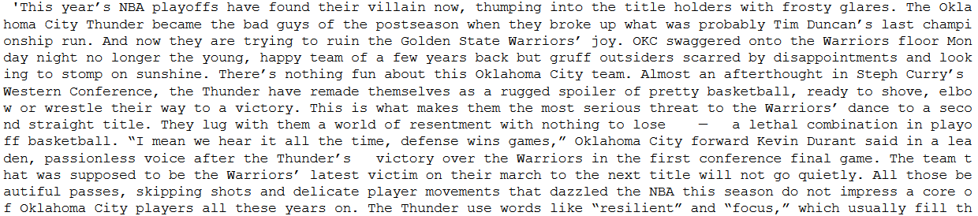
Max similarity in two Documents.
The max Similarity is 0.660201496884226

Slide 13
K-Means Clustering
k-means clustering aims to partition n observations into k clusters in which each observation belongs to the cluster with the nearest mean, serving as a prototype of the cluster. This results in a partitioning of the data space into Voronoi cells.
First we initialize k points, called means, randomly.
We categorize each item to its closest mean and we update the mean’s coordinates, which are the averages of the items categorized in that mean so far.
We repeat the process for a given number of iterations and at the end, we have our clusters.

Slide 14
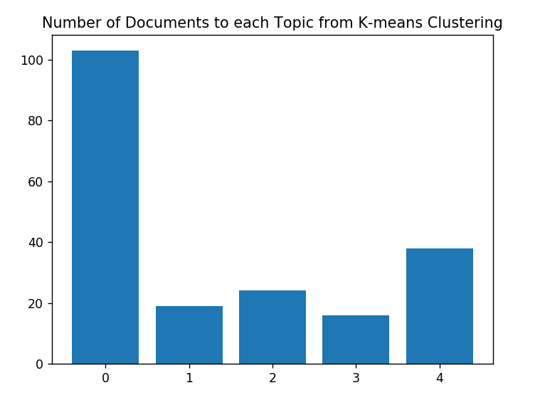
Results form K-Means Clustering
The Frequency of document assigned to each Topic is as shown.
Topic with max frequency has 103 documents and Topic with min frequency has almost 16 documents

Slide 15
Comparison of LSA and K-Means Clustering
Total Document pair possible from 200 documents is 19900
Total Document Pair classified in same Topic through LSA Method is 6645.(May vary with different executions)
Total Document Pair classified in same Topic from K-means out of those 6645 document is 3707. .(May vary with different executions)

Slide 16
Thank You

